Slide 1
Advanced Time Domain models
Lecture 8

Slide 2
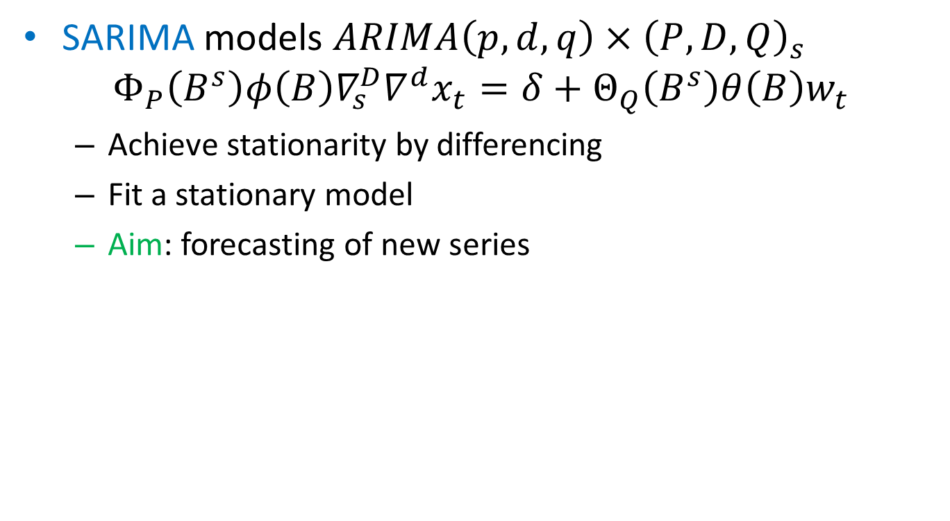
Recap
SARIMA models $ARIMA\left(p,d,q\right)×{\left(P,D,Q\right)}_{s}$
$$Φ_{P}\left(B^{s}\right){φ\left(B\right)∇_{s}^{D}∇^{d}x}_{t}={δ+Θ}_{Q}\left(B^{s}\right)θ\left(B\right)w_{t}$$
Achieve stationarity by differencing
Fit a stationary model
Aim: forecasting of new series

Slide 3
GARCH models
Setting 2:
Variance is highly non-constant→ARIMA might be not applicable
Aim: predict variance of future observations
Important application: economics
→GARCH models (generalized autoregressive conditional heteroscedasticity )
Alternative: state-space models (Advanced ML course…)

Slide 4
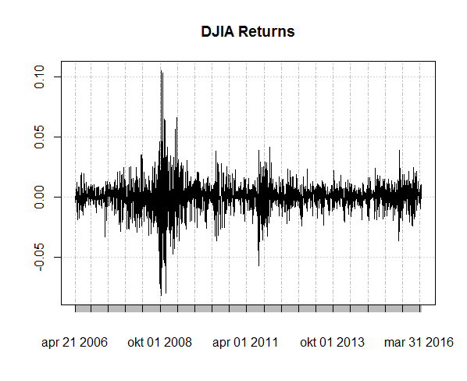
GARCH models
Dow Jones Industrial Average
Forecast pattern of variation!

Slide 5
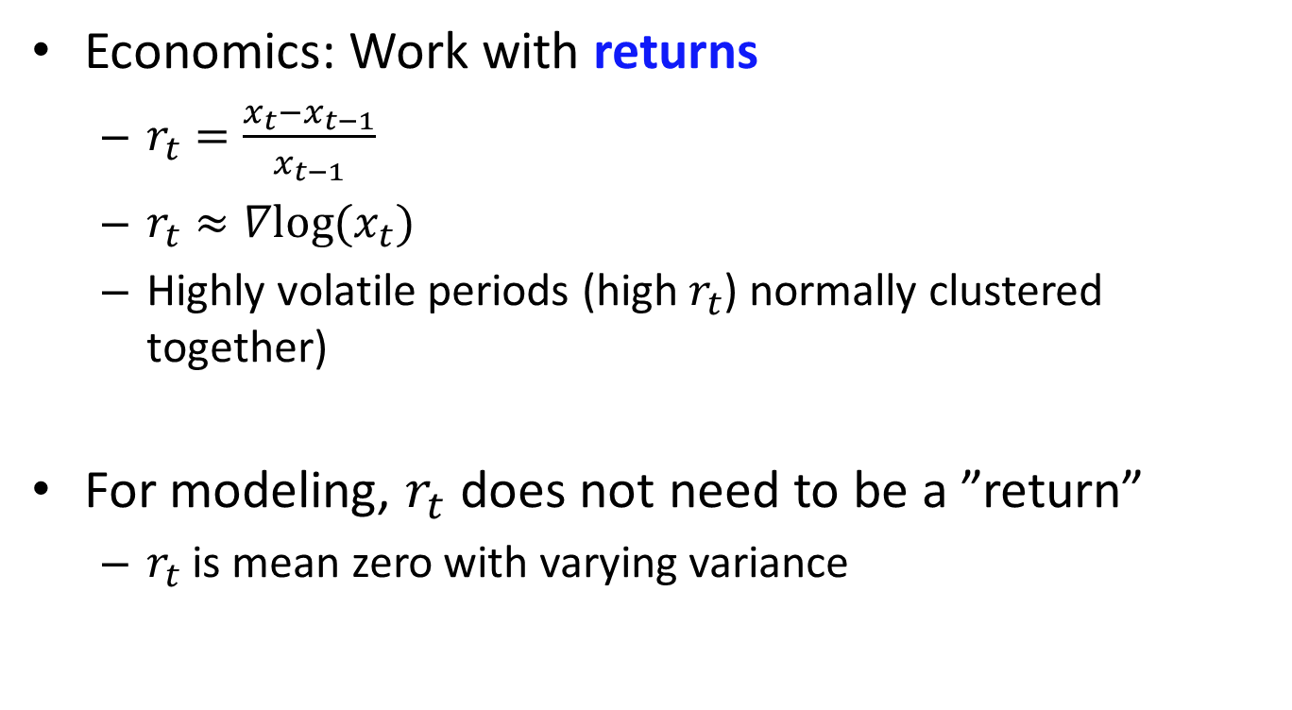
Returns
Economics: Work with returns
$r_{t}=\frac{x_{t}−x_{t−1}}{x_{t−1}}$
$r_{t}≈∇log⁡(x_{t})$
Highly volatile periods (high $r_{t}$) normally clustered together)
For modeling, $r_{t}$ does not need to be a ”return”
$r_{t}$ is mean zero with varying variance

Slide 6
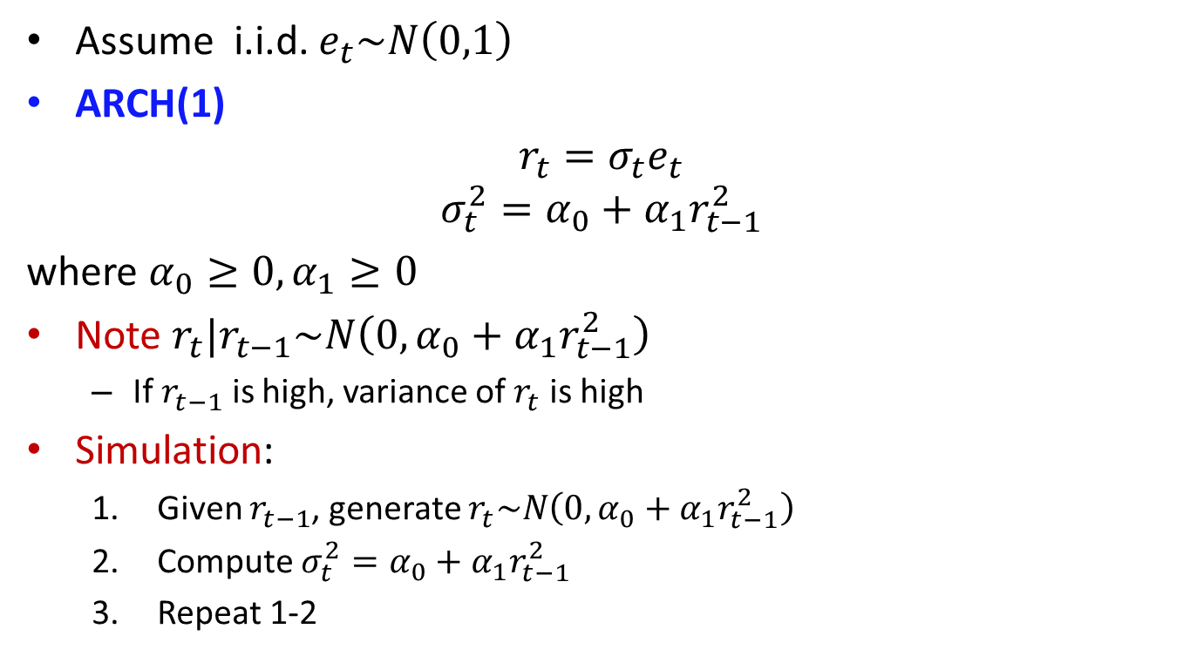
ARCH(1)
Assume i.i.d. $e_{t}\sim N\left(0,1\right)$
ARCH(1)
$$r_{t}=σ_{t}e_{t}$$
$$σ_{t}^{2}=α_{0}+α_{1}r_{t−1}^{2}$$
where $α_{0}≥0, α_{1}≥0$
Note $r_{t}|r_{t−1}\sim N\left(0,α_{0}+α_{1}r_{t−1}^{2}\right)$
If $r_{t−1}$ is high, variance of $r_{t}$ is high
Simulation:
Given $r_{t−1}$, generate $r_{t}\sim N\left(0,α_{0}+α_{1}r_{t−1}^{2}\right)$
Compute $σ_{t}^{2}=α_{0}+α_{1}r_{t−1}^{2}$
Repeat 1-2

Slide 7
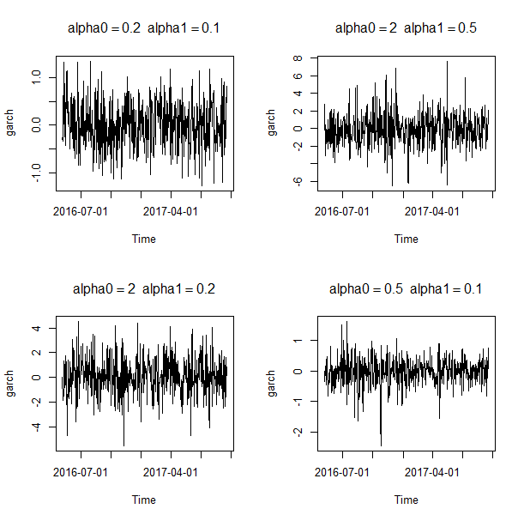
ARCH(1)
Simulated data
Conclusions?

Slide 8
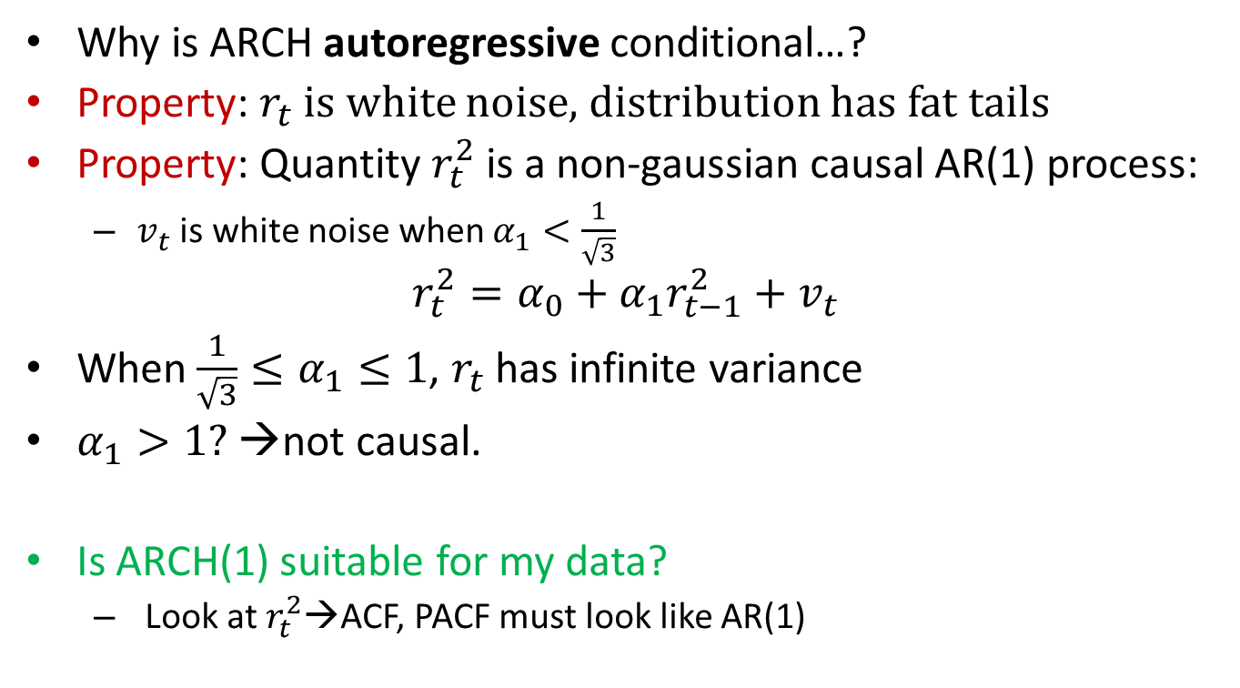
Properties of ARCH(1)
Why is ARCH autoregressive conditional…?
Property: $r_{t}$ is white noise, distribution has fat tails
Property: Quantity $r_{t}^{2}$ is a non-gaussian causal AR(1) process:
$v_{t}$ is white noise when $α_{1}<\frac{1}{\sqrt{3}}$
$$r_{t}^{2}=α_{0}+α_{1}r_{t−1}^{2}+v_{t}$$
When$\frac{1}{\sqrt{3}}≤α_{1}≤1$, $r_{t}$ has infinite variance
$α_{1}>1?$ →not causal.
Is ARCH(1) suitable for my data?
Look at $r_{t}^{2}$→ACF, PACF must look like AR(1)

Slide 9
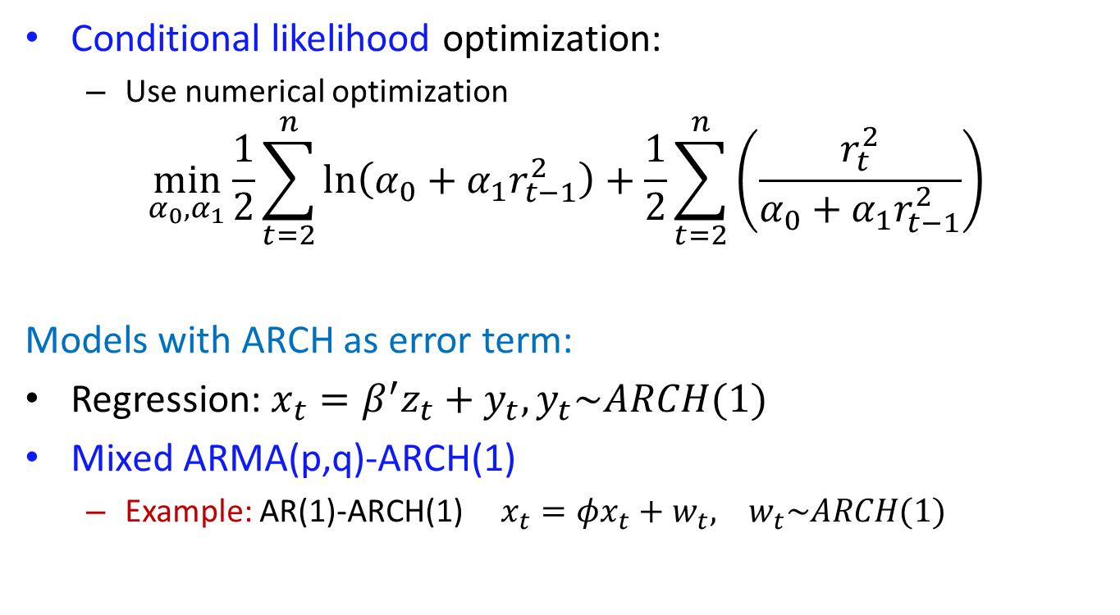
Estimation of ARCH(1)
Conditional likelihood optimization:
Use numerical optimization
$$\min_{α_{0},α_{1}}{\frac{1}{2}\sum_{t=2}^{n}{\ln\left(α_{0}+α_{1}r_{t−1}^{2}\right)}+\frac{1}{2}\sum_{t=2}^{n}{\left(\frac{r_{t}^{2}}{α_{0}+α_{1}r_{t−1}^{2}}\right)}}$$
Models with ARCH as error term:
Regression: $x_{t}=β^{′}z_{t}+y_{t}, y_{t}\sim ARCH(1)$
Mixed ARMA(p,q)-ARCH(1)
Example: AR(1)-ARCH(1) $x_{t}=φx_{t}+w_{t}, w_{t}\sim ARCH(1)$

Slide 10
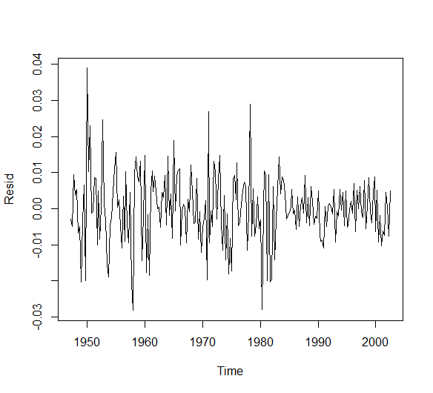
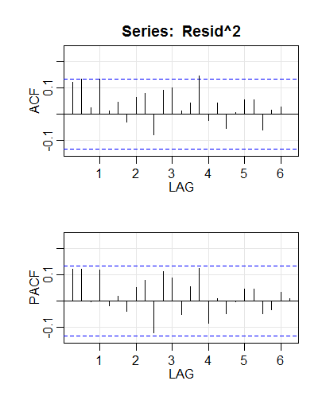
Mixed ARMA-ARCH
Example: GNP series
Fitting AR(1) to diff(log(gnp))
Is variance constant?
Does ACF suggest ARCH(1)?

Slide 11
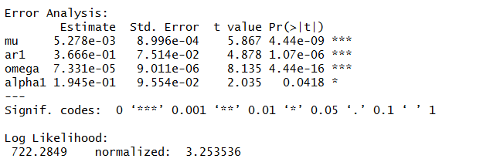
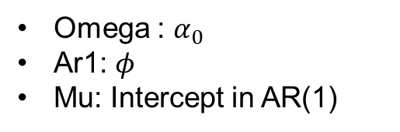
Mixed ARMA-ARCH
Example: GNP series
Fitting AR(1)-ARCH(1) to diff(log(gnp))
fit=garchFit(~arma(1,0)+garch(1,0),data=lgnp)
summary(fit)
Omega : $α_{0}$
Ar1: $φ$
Mu: Intercept in AR(1)

Slide 12
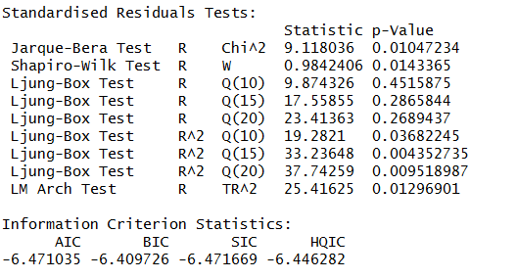
Mixed ARMA-ARCH
Example: GNP series
Jarque-Bera: Small p=non-normal residuals
Shapiro-Wilk: Small p=non-normal residuals
Ljung-Box: Small p=dependent residuals

Slide 13
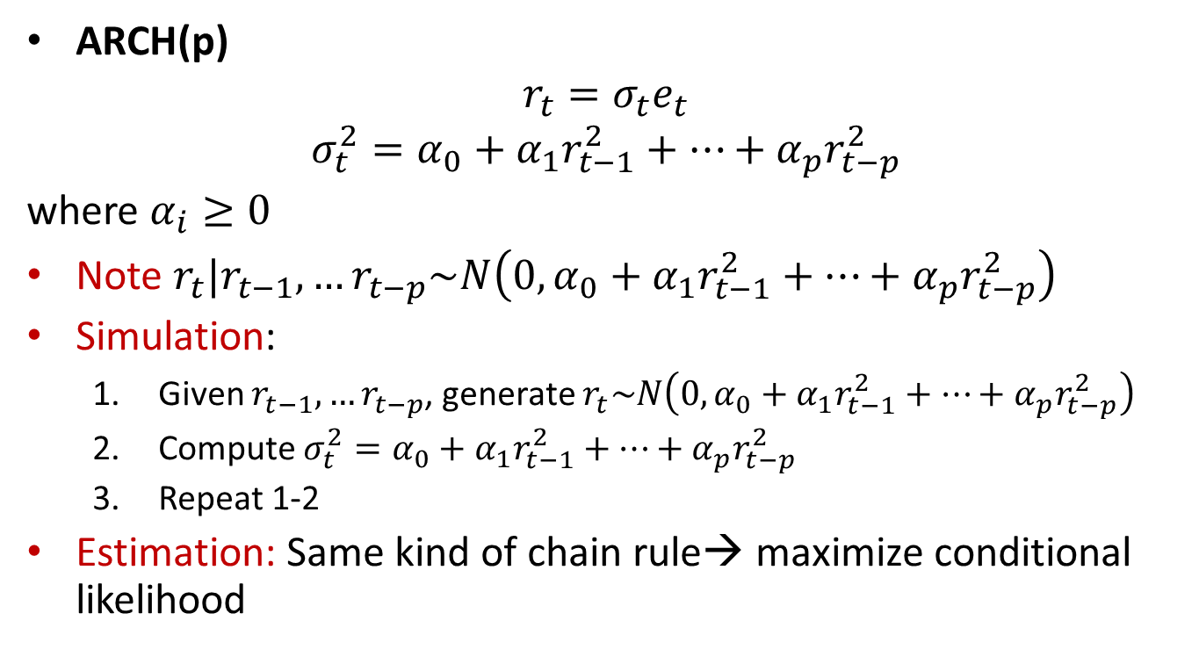
ARCH(p)
ARCH(p)
$$r_{t}=σ_{t}e_{t}$$
$$σ_{t}^{2}=α_{0}+α_{1}r_{t−1}^{2}+…+α_{p}r_{t−p}^{2}$$
where $α_{i}≥0$
Note $r_{t}|r_{t−1},…r_{t−p}\sim N\left(0,α_{0}+α_{1}r_{t−1}^{2}+…+α_{p}r_{t−p}^{2}\right)$
Simulation:
Given $r_{t−1},…r_{t−p}$, generate $r_{t}\sim N\left(0,α_{0}+α_{1}r_{t−1}^{2}+…+α_{p}r_{t−p}^{2}\right)$
Compute $σ_{t}^{2}=α_{0}+α_{1}r_{t−1}^{2}+…+α_{p}r_{t−p}^{2}$
Repeat 1-2
Estimation: Same kind of chain rule→ maximize conditional likelihood

Slide 14
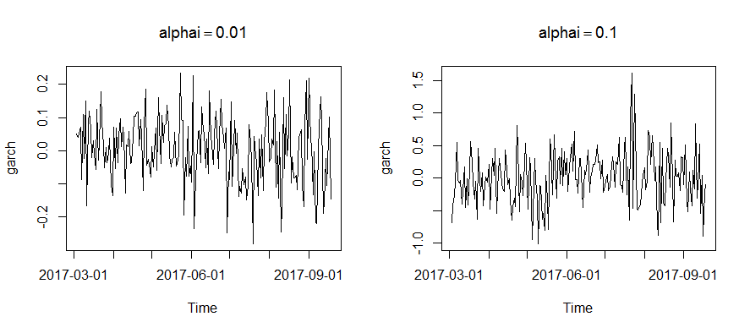

ARCH(p)
Example: Simulated data
ARCH(p), $α_{i}=0.01, p=5$
ARCH(p), $α_{i}=0.1, p=5$

Slide 15
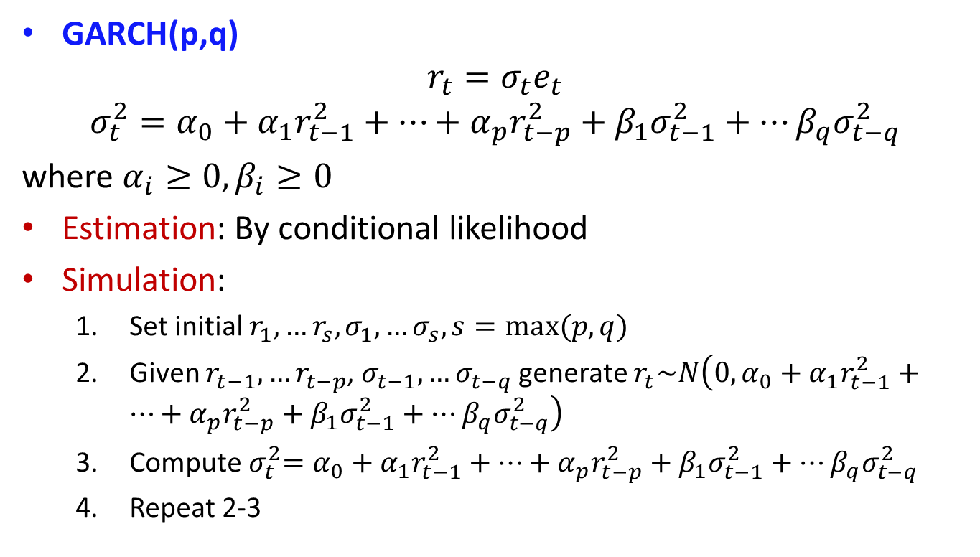
GARCH(p,q)
GARCH(p,q)
$$r_{t}=σ_{t}e_{t}$$
$$σ_{t}^{2}=α_{0}+α_{1}r_{t−1}^{2}+…+α_{p}r_{t−p}^{2}+β_{1}σ_{t−1}^{2}+…β_{q}σ_{t−q}^{2}$$
where $α_{i}≥0, β_{i}≥0$
Estimation: By conditional likelihood
Simulation:
Set initial $r_{1},…r_{s}, σ_{1},…σ_{s}, s=max⁡(p,q)$
Given $r_{t−1},…r_{t−p}$, $σ_{t−1},…σ_{t−q}$generate $r_{t}\sim N\left(0,α_{0}+α_{1}r_{t−1}^{2}+…+α_{p}r_{t−p}^{2}+β_{1}σ_{t−1}^{2}+…β_{q}σ_{t−q}^{2}\right)$
Compute${ σ}_{t}^{2}=α_{0}+α_{1}r_{t−1}^{2}+…+α_{p}r_{t−p}^{2}+β_{1}σ_{t−1}^{2}+…β_{q}σ_{t−q}^{2}$
Repeat 2-3

Slide 16
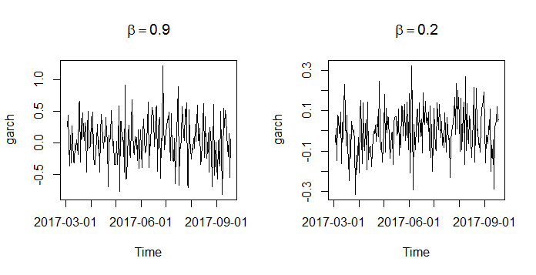

GARCH(p,q)
Example: GARCH(1,1) $α_{0}=0.01, α_{1}=0.01$

Slide 17
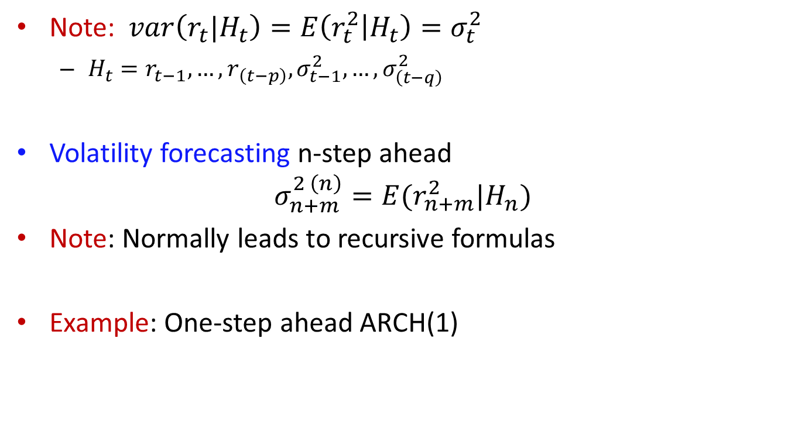
Forecasting GARCH(p,q)
Note: $var\left(r_{t}|H_{t}\right)=E\left(r_{t}^{2} | H_{t}\right)=σ_{t}^{2}$
$H_{t}=r_{t−1},…,r_{\left(t−p\right)},σ_{t−1}^{2},…,σ_{\left(t−q\right)}^{2}$
Volatility forecasting n-step ahead
$$σ_{n+m}^{2 \left(n\right)}=E(r_{n+m}^{2}|H_{n})$$
Note: Normally leads to recursive formulas
Example: One-step ahead ARCH(1)

Slide 18
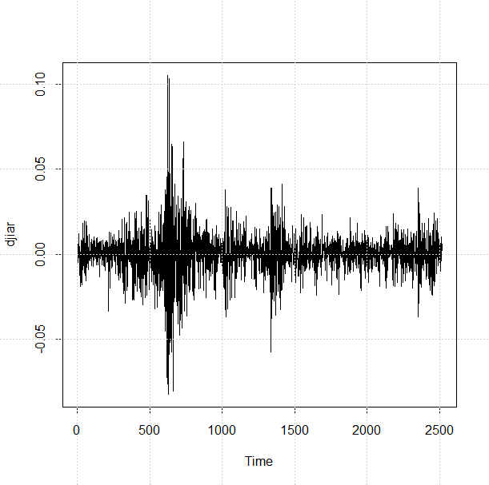
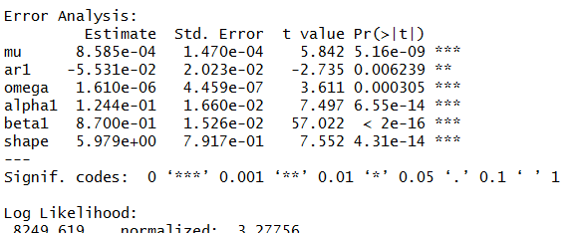
GARCH models
Example: Dow Jones returns
Model: ARMA(1,0)-GARCH(1,1)

Slide 19
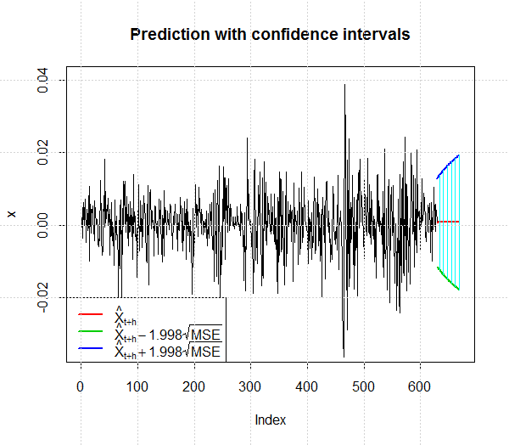
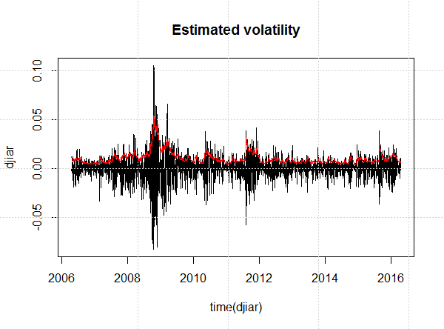
GARCH models
Example: Dow Jones returns
Model: ARMA(1,0)-GARCH(1,1)

Slide 20
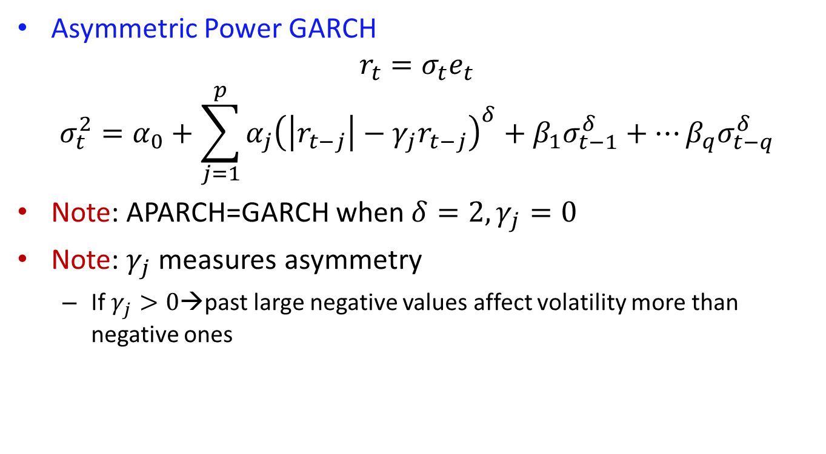
APARCH models
Asymmetric Power GARCH
$$r_{t}=σ_{t}e_{t}$$
$$σ_{t}^{2}=α_{0}+\sum_{j=1}^{p}{α_{j}{\left(\left|r_{t−j}\right|−γ_{j}r_{t−j}\right)}^{δ}}+β_{1}σ_{t−1}^{δ}+…β_{q}σ_{t−q}^{δ}$$
Note: APARCH=GARCH when $δ=2, γ_{j}=0$
Note: $γ_{j}$ measures asymmetry
If $γ_{j}>0$→past large negative values affect volatility more than negative ones

Slide 21
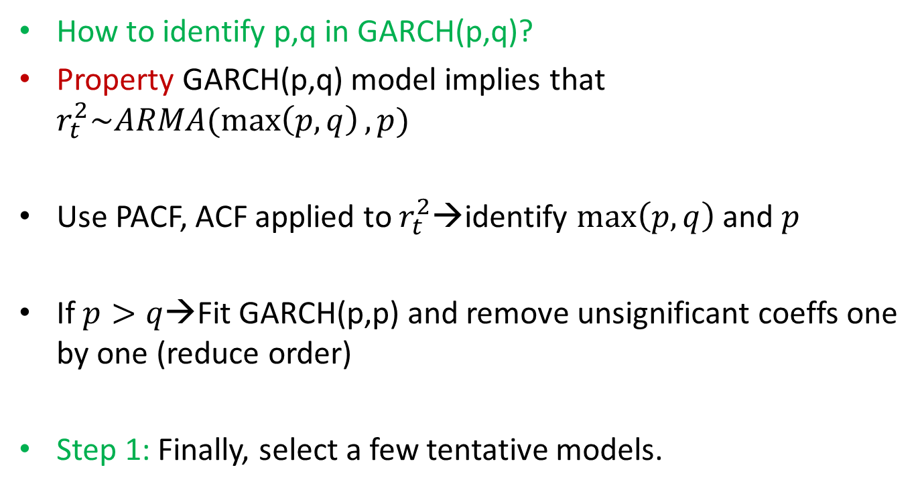
Model selection
How to identify p,q in GARCH(p,q)?
Property GARCH(p,q) model implies that $r_{t}^{2}\sim ARMA(\max\left(p,q\right),p)$
Use PACF, ACF applied to $r_{t}^{2}$→identify $\max\left(p,q\right)$ and $p$
If $p>q$→Fit GARCH(p,p) and remove unsignificant coeffs one by one (reduce order)
Step 1: Finally, select a few tentative models.

Slide 22
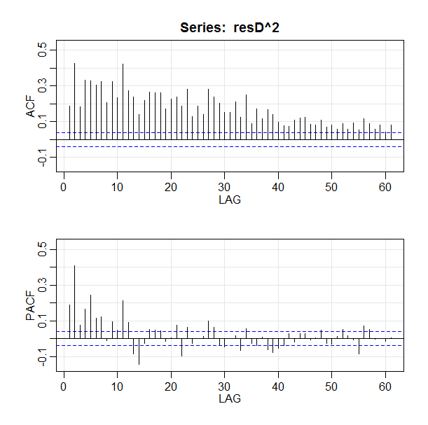
Model selection
Example: Dow Jones series
Conclusion?

Slide 23
Model selection
Step 2: Fitting and model selection
Analytical measures: AIC, BIC
Residual analysis
Residual plot
ACF plots of residuals
Q-Q plot standardized residuals (innovations)→normal?
Tests provided by software (Jarque-Bera, Ljung-Box etc.)

Slide 24
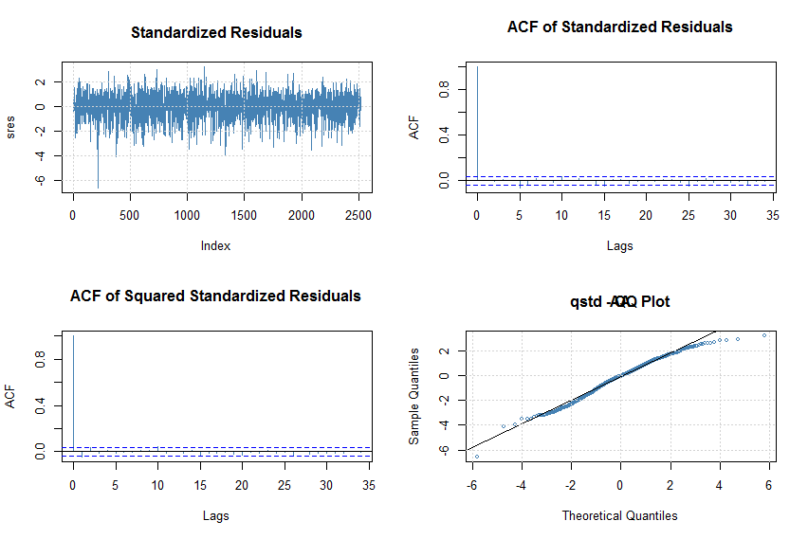
Model selection
Example: Dow Jones series
ARMA(1,0)-GARCH(1,1)

Slide 25
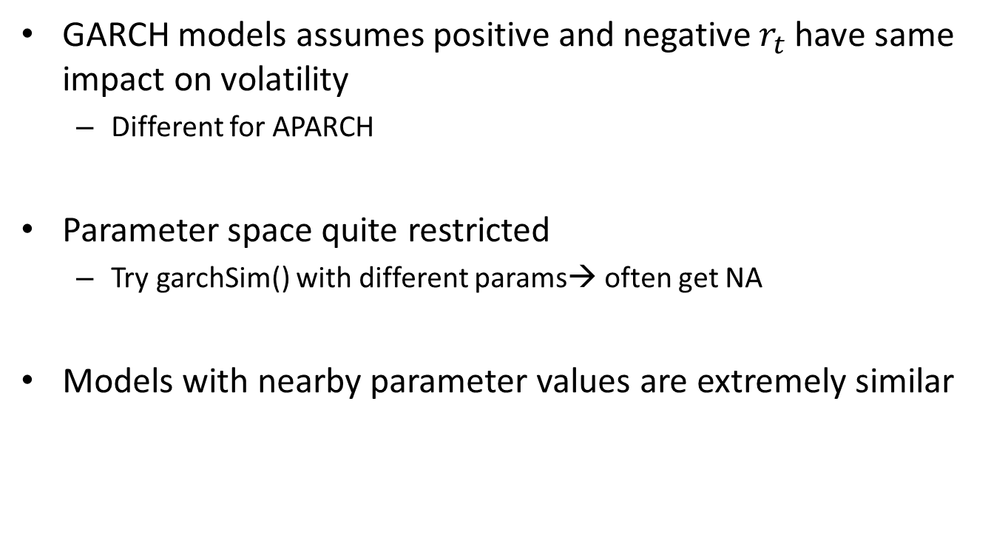
GARCH models- limitations
GARCH models assumes positive and negative $r_{t}$ have same impact on volatility
Different for APARCH
Parameter space quite restricted
Try garchSim() with different params→ often get NA
Models with nearby parameter values are extremely similar

Slide 26
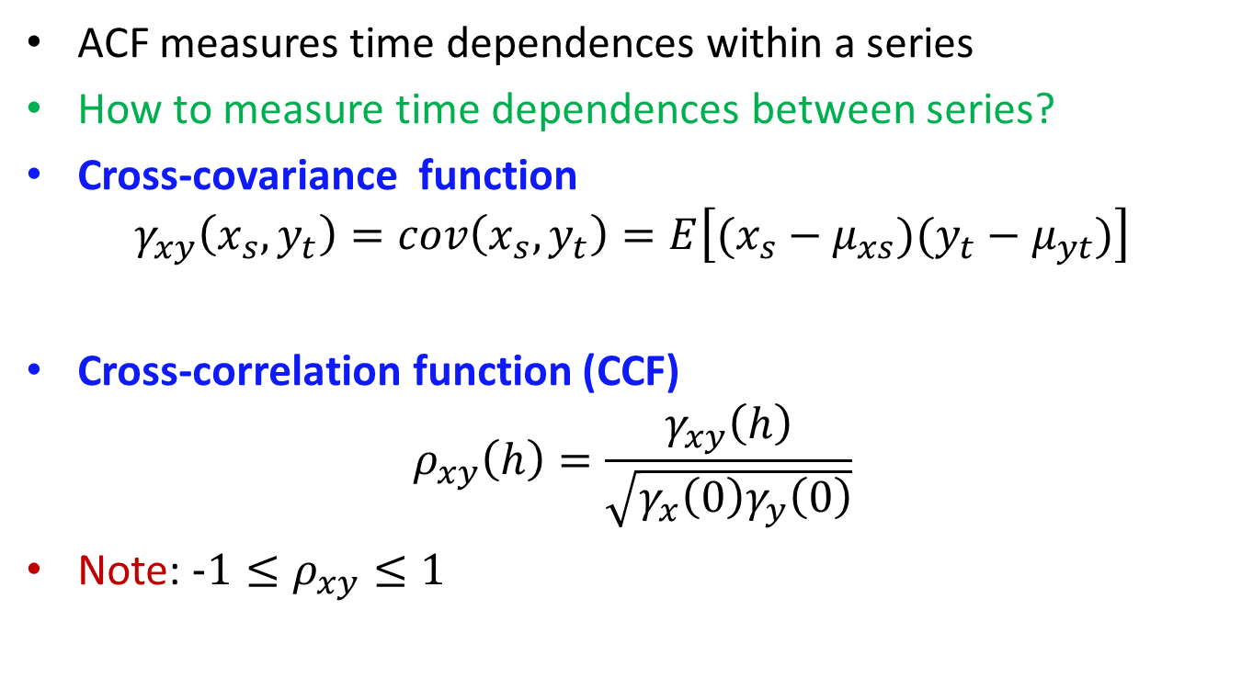
Cross-covariance and CCF
ACF measures time dependences within a series
How to measure time dependences between series?
Cross-covariance function
$$γ_{xy}\left(x_{s},y_{t}\right)=cov\left(x_{s},y_{t}\right)=E\left[(x_{s}−μ_{xs})(y_{t}−μ_{yt})\right]$$
Cross-correlation function (CCF)
$$ρ_{xy}\left(h\right)=\frac{γ_{xy}\left(h\right)}{\sqrt{γ_{x}\left(0\right)γ_{y}\left(0\right)}}$$
Note: $−1≤ρ_{xy}≤1$

Slide 27
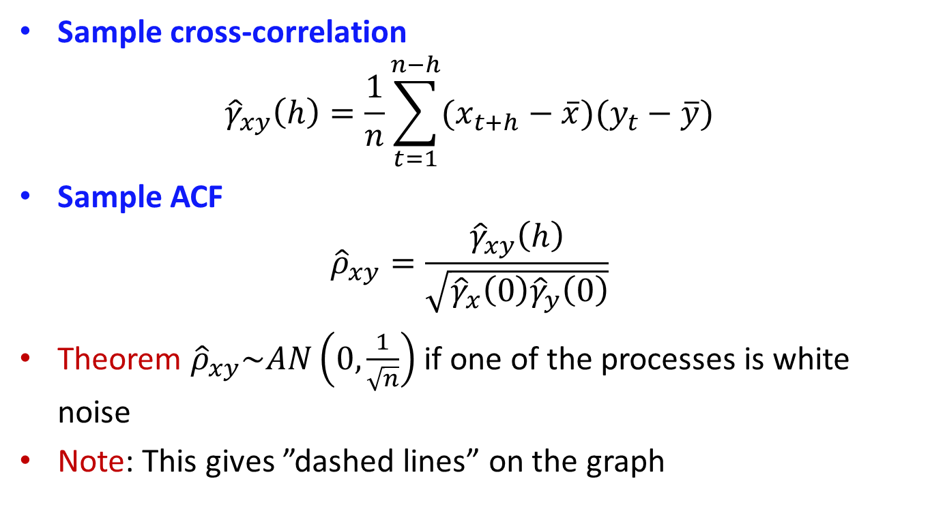
Sample CCF
Sample cross-correlation
$${\hat{γ}}_{xy}\left(h\right)=\frac{1}{n}\sum_{t=1}^{n−h}{(x_{t+h}−\overline{x})(y_{t}−\overline{y})}$$
Sample ACF
$${\hat{ρ}}_{xy}=\frac{{\hat{γ}}_{xy}\left(h\right)}{\sqrt{{\hat{γ}}_{x}\left(0\right){\hat{γ}}_{y}\left(0\right)}}$$
Theorem ${\hat{ρ}}_{xy}\sim AN\left(0,\frac{1}{\sqrt{n}}\right)$ if one of the processes is white noise
Note: This gives ”dashed lines” on the graph

Slide 28
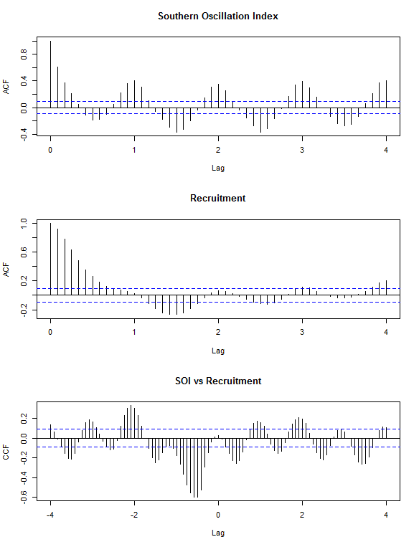
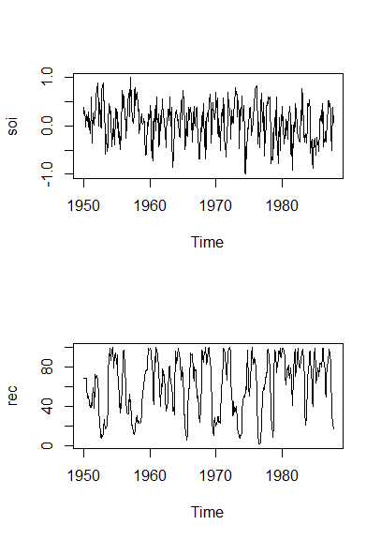
Cross-covariance and CCF
Example: SOI and Recruitment
Conclusion?
Can we trust dashed lines at CCF?

Slide 29
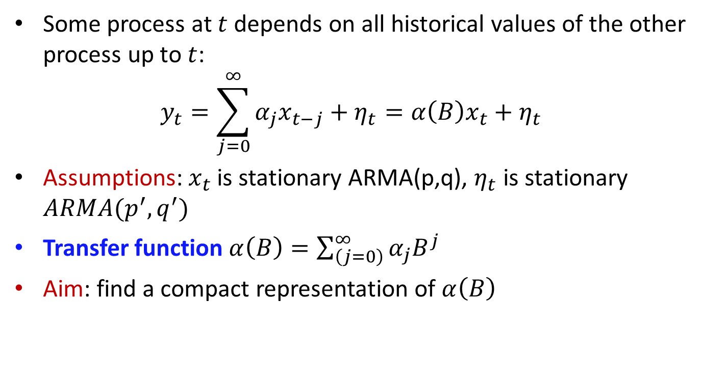
Transfer function modeling
Some process at $t$ depends on all historical values of the other process up to $t$:
$$y_{t}=\sum_{j=0}^{∞}{α_{j}x_{t−j}}+η_{t}=α\left(B\right)x_{t}+η_{t}$$
Assumptions: $x_{t}$ is stationary ARMA(p,q), $η_{t}$ is stationary $ARMA(p^{′},q^{′})$
Transfer function $α\left(B\right)=\sum_{\left(j=0\right)}^{∞}{α_{j}B^{j}}$
Aim: find a compact representation of $α\left(B\right)$

Slide 30
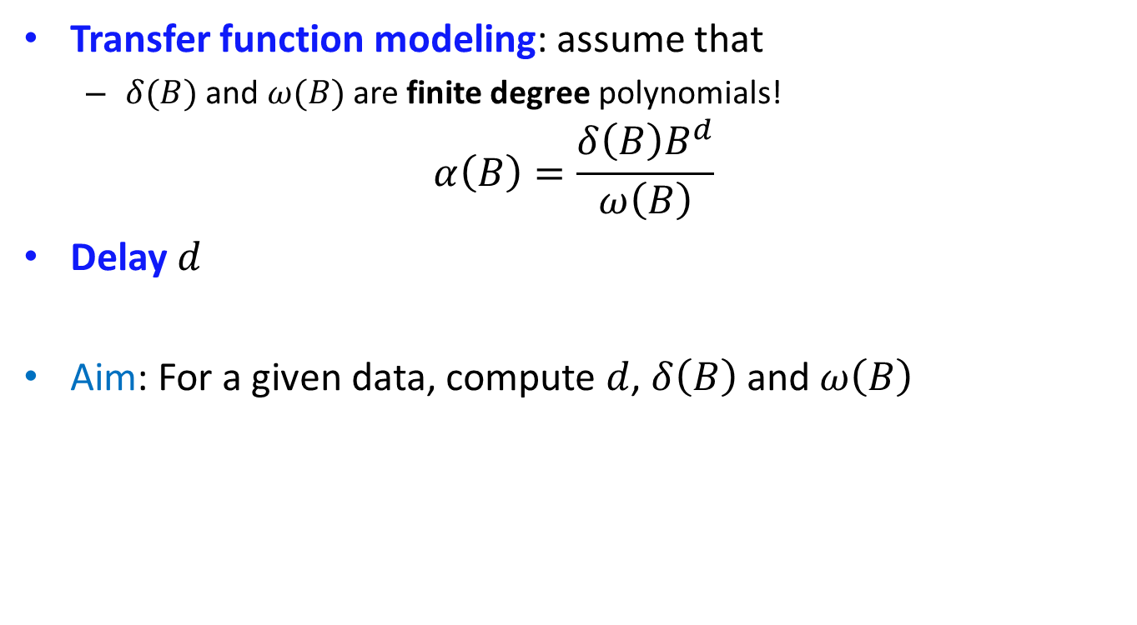
Transfer function modeling
Transfer function modeling: assume that
$δ(B)$ and $ω(B)$ are finite degree polynomials!
$$α\left(B\right)=\frac{δ\left(B\right)B^{d}}{ω\left(B\right)}$$
Delay $d$
Aim: For a given data, compute $d$, $δ\left(B\right)$ and $ω\left(B\right)$

Slide 31
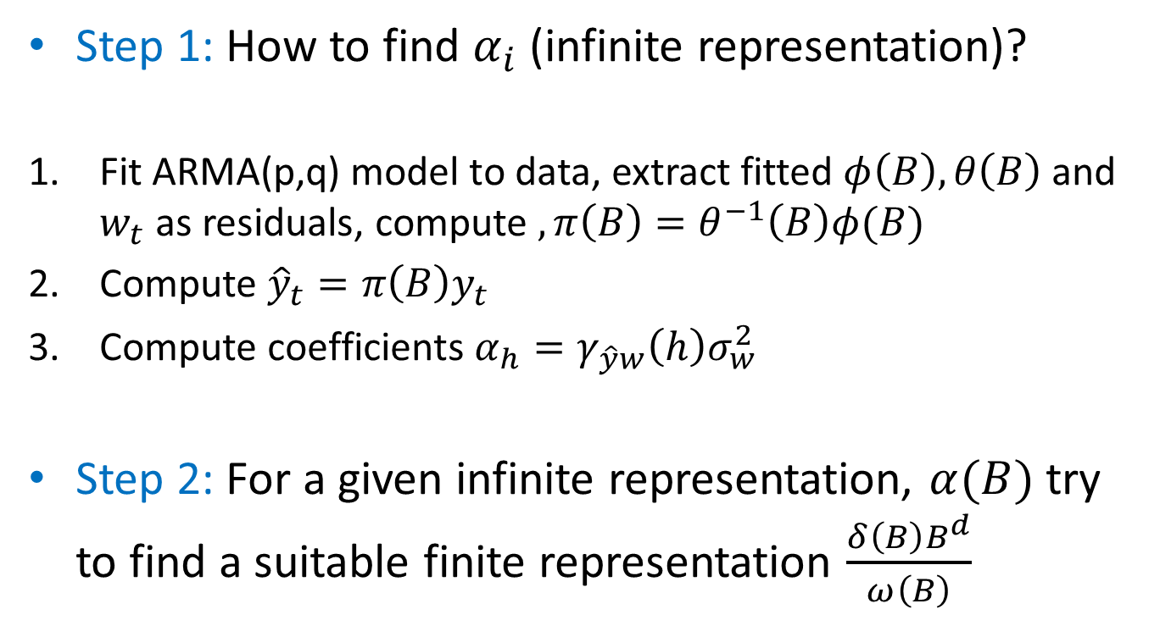
Transfer function modeling
Step 1: How to find $α_{i}$ (infinite representation)?
Fit ARMA(p,q) model to data, extract fitted $φ\left(B\right),θ\left(B\right)$and $w_{t}$ as residuals, compute $,π\left(B\right)=θ^{−1}\left(B\right)φ(B)$
Compute ${\hat{y}}_{t}=π\left(B\right)y_{t}$
Compute coefficients $α_{h}=γ_{\hat{y}w}\left(h\right)σ_{w}^{2}$
Step 2: For a given infinite representation, $α(B)$ try to find a suitable finite representation $\frac{δ\left(B\right)B^{d}}{ω\left(B\right)}$

Slide 32
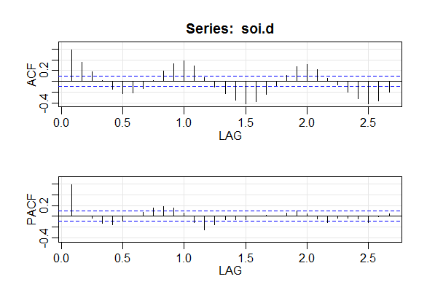

Transfer function modeling
Example. SOI and Recruitment series
$x_{t}=SOI$, $y_{t}=Recruitment$
Which model suitable?

Slide 33
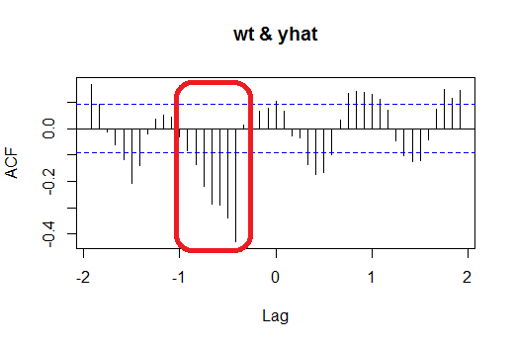

Transfer function modeling
Example. SOI and Recruitment series
$x_{t}=SOI$, $y_{t}=Recruitment$
$$α\left(B\right)=\frac{B^{5}}{1+ω_{1}B}$$
Decaying trend, starts at -5

Slide 34
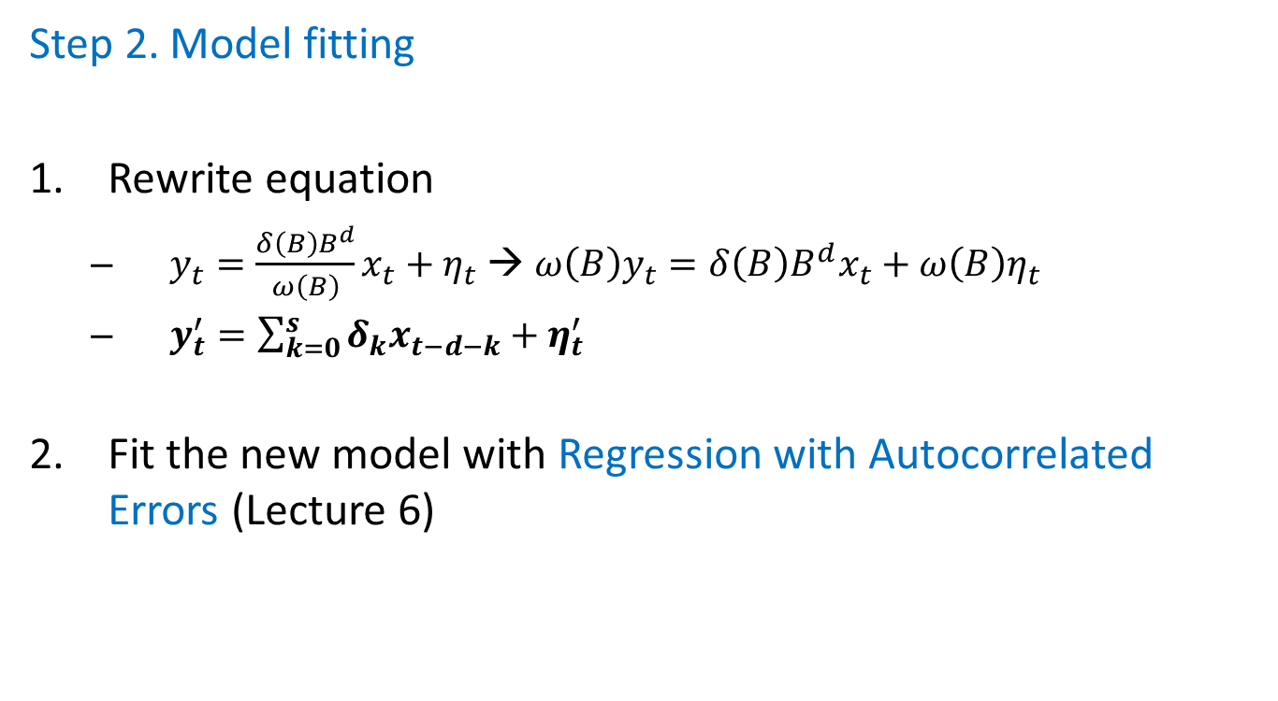
Transfer function modeling
Step 2. Model fitting
Rewrite equation
$y_{t}=\frac{δ\left(B\right)B^{d}}{ω\left(B\right)}x_{t}+η_{t}$ → ${ω\left(B\right)y}_{t}=δ\left(B\right)B^{d}x_{t}+ω\left(B\right)η_{t}$
$y_{t}^{′}=\sum_{k=0}^{s}{δ_{k}x_{t−d−k}+η_{t}^{′}}$
Fit the new model with Regression with Autocorrelated Errors (Lecture 6)

Slide 35
Read home
SS, ch. 5.3, 5.5

